Slide 1
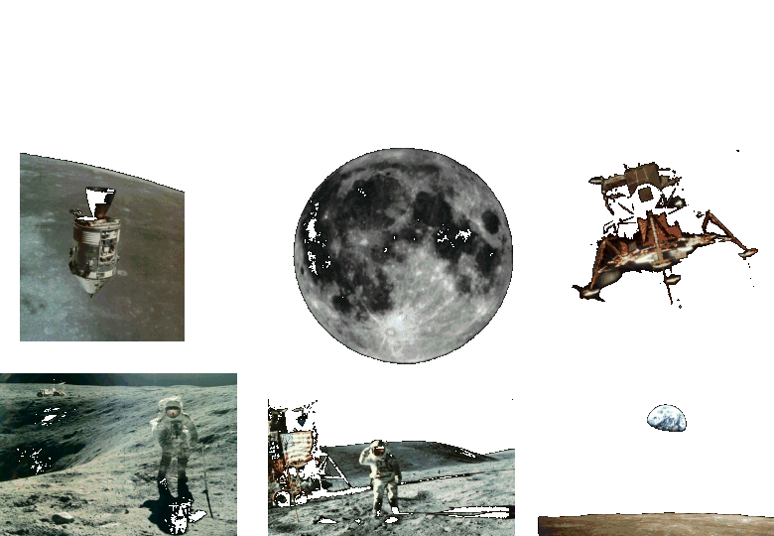
Apollo to the Moon

Slide 2
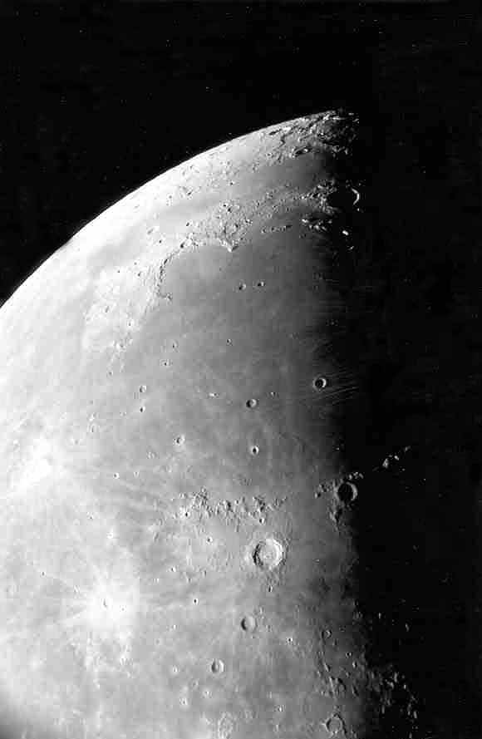
Moon maria as seen through the telescope.
Photo by Jim Fullerton

Slide 3
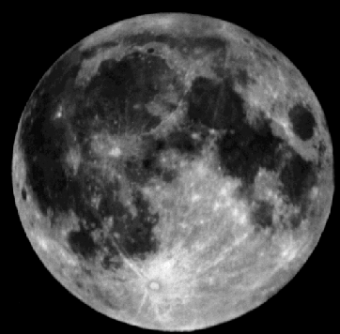
The maria (mare) are the smooth dark areas on the surface of the Moon.
Mare
Highlands

Slide 4
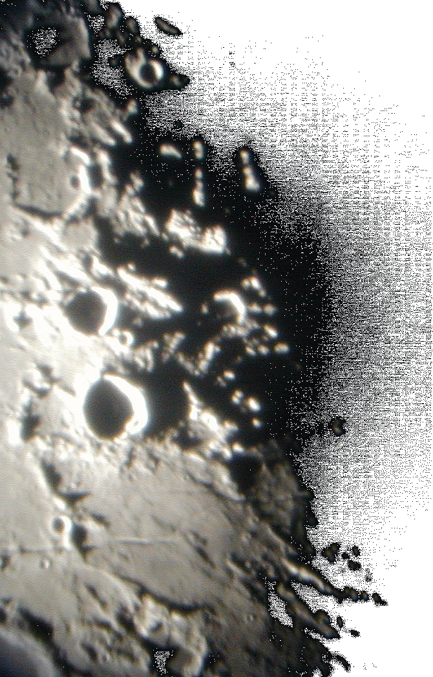
The Moon=s many craters and other features are best seen near the terminator - the line between day and night.
Photo by Lake Afton Public Observatory

Slide 5
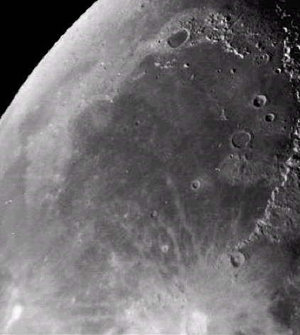
This photo shows a smooth floored lunar mare. You can easily see the ancient rim of the original impact basin.
Mare Imbrium

Slide 6
The maria were formed about 3.5 – 4 billion years ago.
Lava flowed through cracks in the lunar surface and filled in low laying areas.
Mare Imbrium

Slide 7
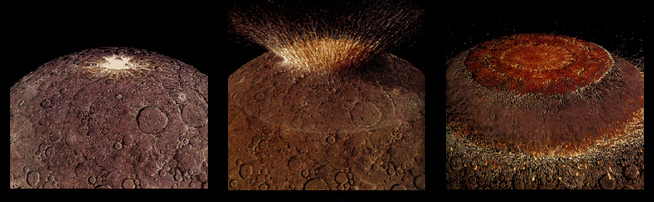
Four billion years ago the impact from a large asteroid formed a huge multi-ringed basin which then thinned and fractured the lunar crust.

Slide 8
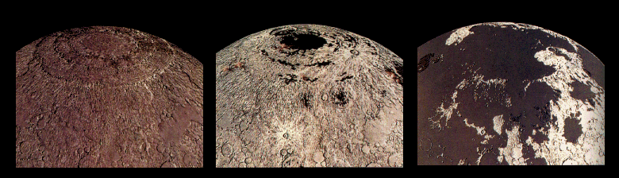
Fluid lavas from beneath the moon’s crust flowed out and flooded the low regions of the lunar surface – covering up many craters.

Slide 9
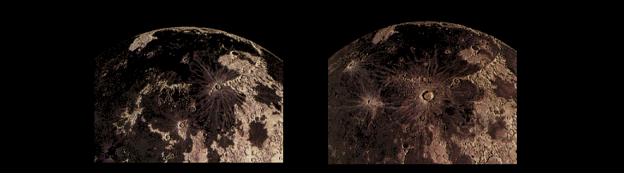
Less than a billion years after they began, the lavas ceased flowing out onto the Moons surface. However, occasionally new craters were created on top of these ancient flows.

Slide 10
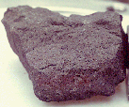
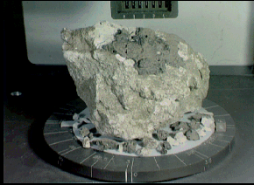
Lunar rock samples from the moon’s maria are dark colored rocks.
Samples from the highland regions are much lighter in color.

Slide 11
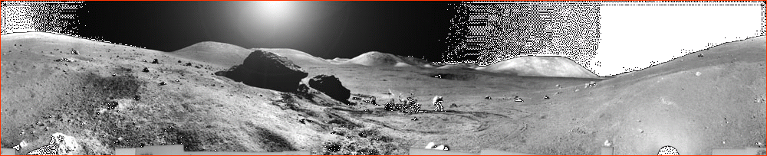
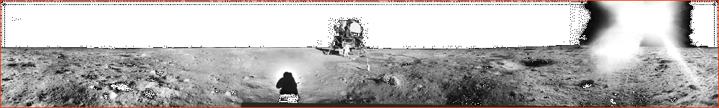
One of these shows the lunar surface from a mare and the other the highlands.
Can you tell which is which?

Slide 12
The highlands are rugged.
The mare are smooth & flat.

Slide 13
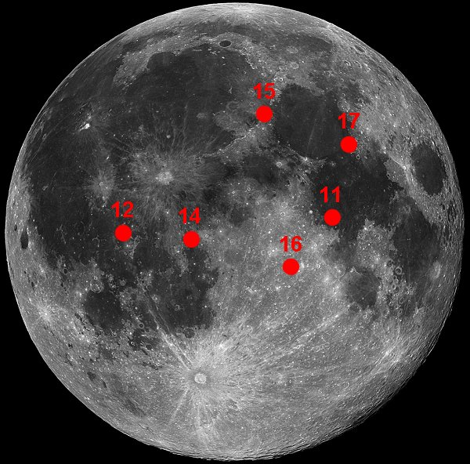
Apollo 17 Landing Site

Slide 14
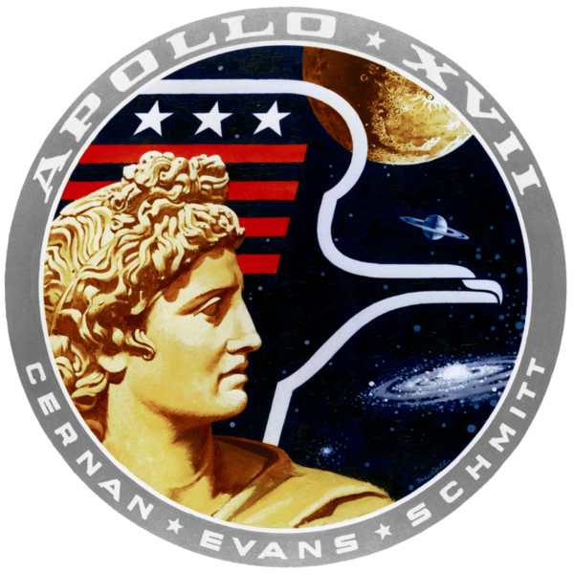
Apollo 17 –
Cernan, Schmitt & Evans
The primary mission objectives were to explore and get samples from the Taurus-Littrow valley and set up the final Apollo Lunar Surface Experiments Package.

Slide 15
Apollo 17 –
Cernan, Schmitt & Evans
The secondary mission objective was to conduct in-flight experiments and photographic tasks from lunar orbit.

Slide 16
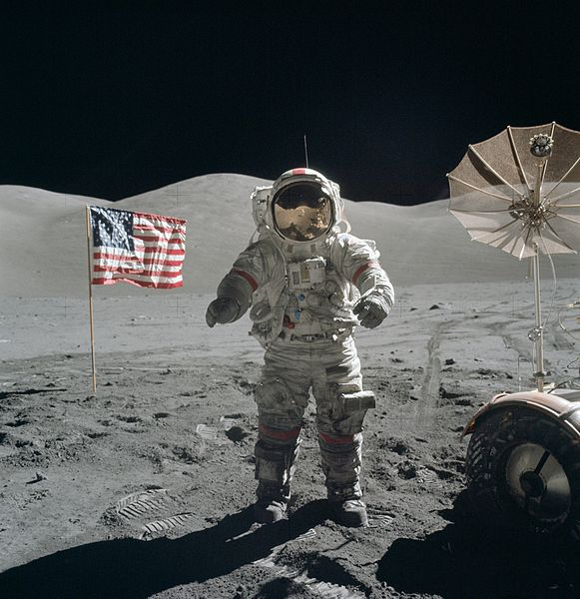
Apollo 17
They hoped to find uplifted lunar crust material from before the Sea of Serenity had formed near the Taurus-Littrow landing site.

Slide 17
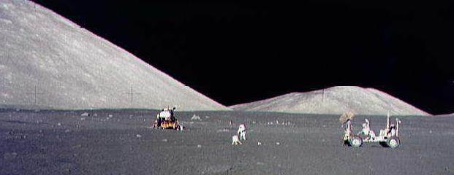
Apollo 17
Record Setting Mission
Distance traveled from the lunar module (5.7 miles).
Steepest slope driven up in the Rover (~26°).
The most territory covered (18.6 miles).
The most samples returned (242 lb).
The longest stay on the lunar surface (~75 hrs).

Slide 18
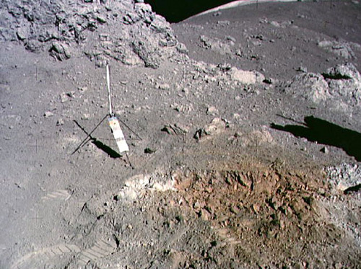
Apollo 17
A surprise find of orange soil at station 4 near Shorty Crater was highly unusual and of particular interest.

Slide 19
Apollo 17
Years later it was determined that the orange soil most likely formed from a lava fountain during an eruptive event 3.6 billion years ago

Slide 20
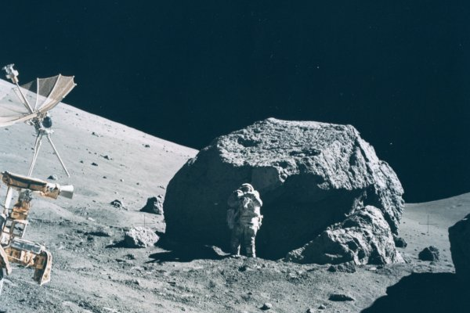
Apollo 17
Apollo 17 is considered to have had the best science return of any Apollo mission, largely due to having a geologist as part of the lunar surface crew.

Slide 21
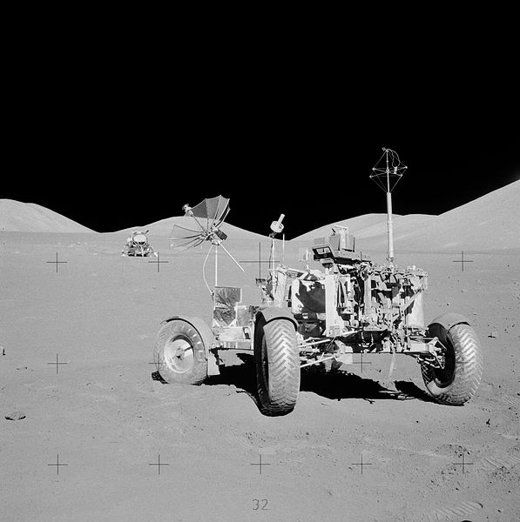
Apollo 17
Apollo 17 Rover at its final resting place. The Lunar Module can be seen in the background.

